Slide 1

Stack
Presented by:
Elizer Ponio Jr.

Slide 2
What is a Stack?
A stack is a linear data structure that follows the principle of Last In First Out (LIFO). This means the last element inserted inside the stack is removed first.
Notes:
Have you asked yourself the question, why do people organize?
Lets go to the psychology of organizing
This predictability applies within the context of our homes, manifesting through the concept of organization

Slide 3
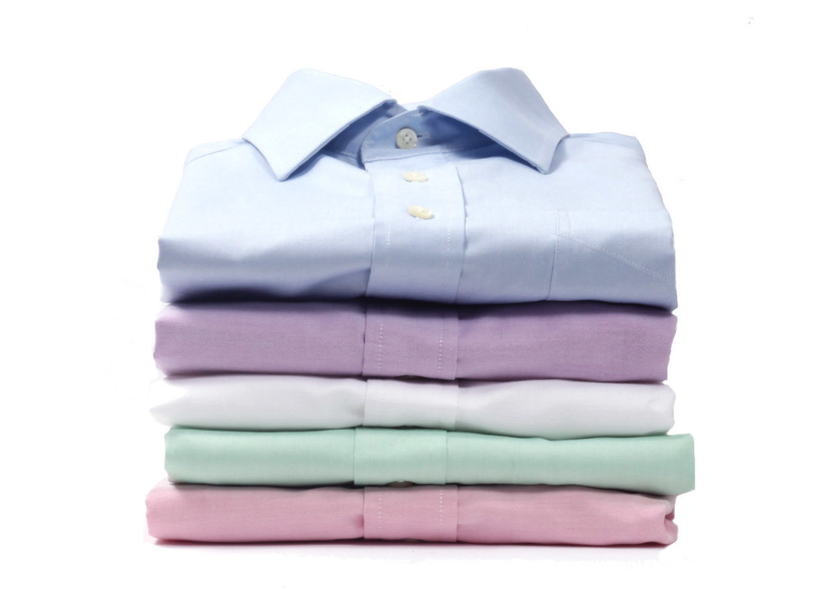
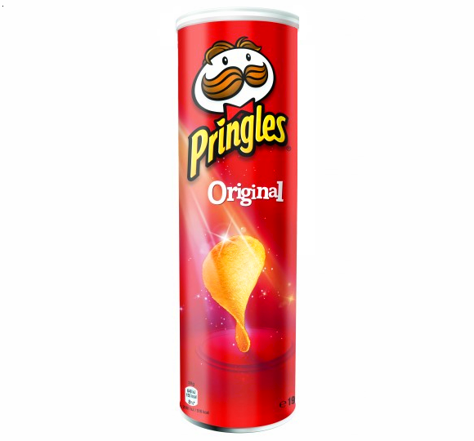
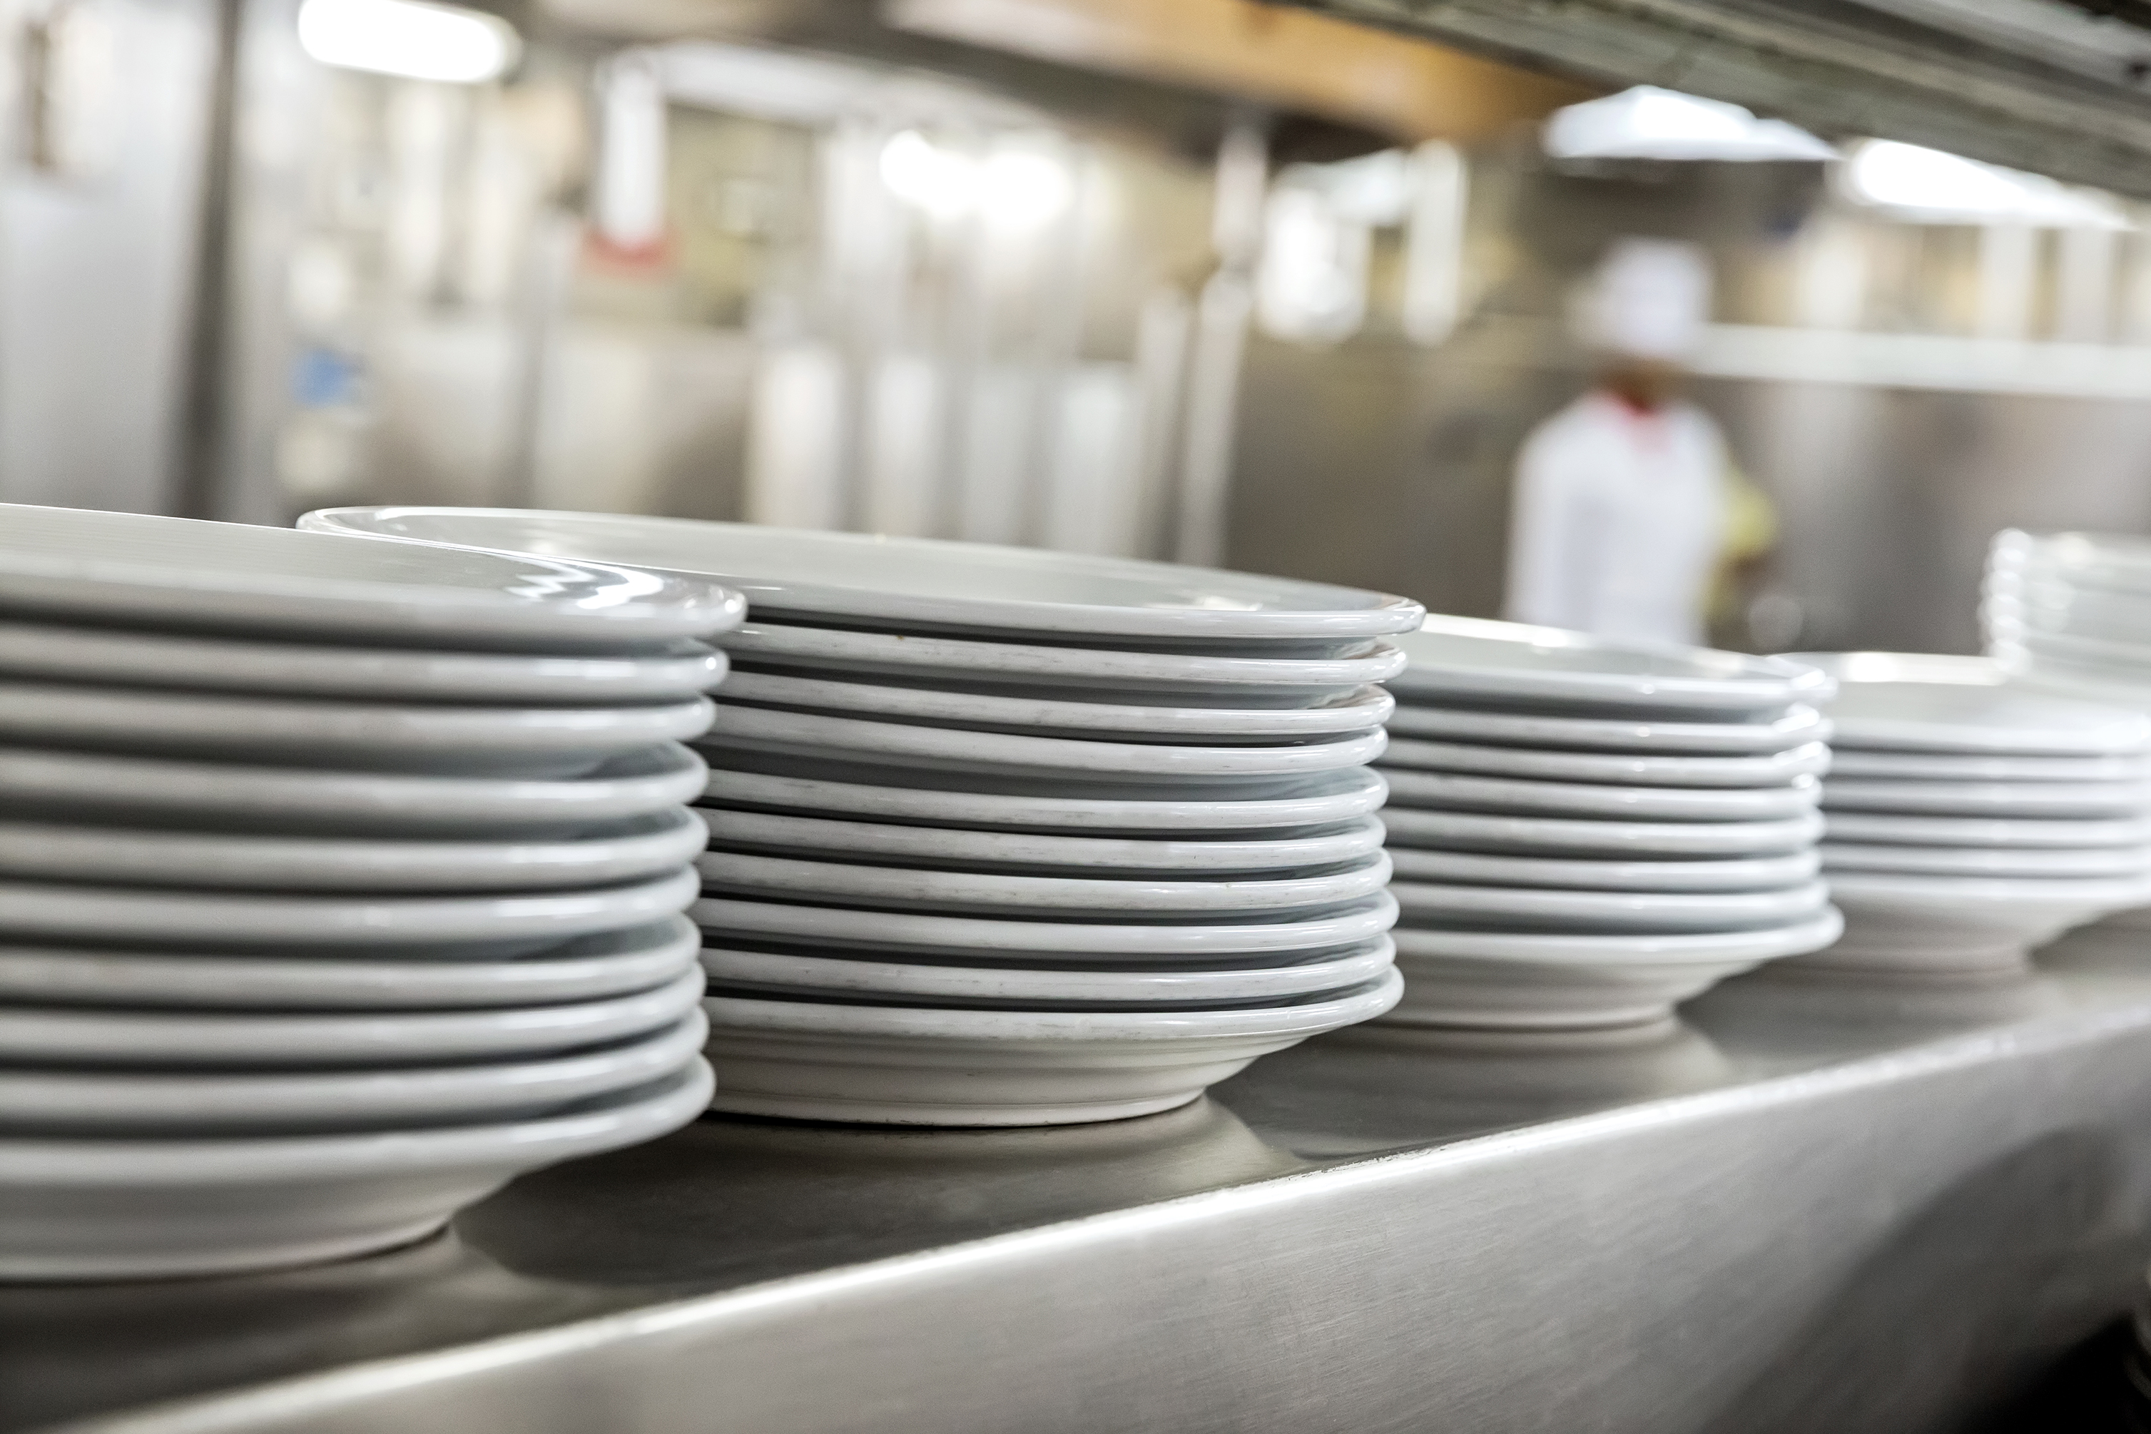
What is a Stack?
This Photo by Unknown Author is licensed under CC BY
Notes:
Have you asked yourself the question, why do people organize?
Lets go to the psychology of organizing
This predictability applies within the context of our homes, manifesting through the concept of organization

Slide 4
Last In First Out
Notes:
Have you asked yourself the question, why do people organize?
Lets go to the psychology of organizing
This predictability applies within the context of our homes, manifesting through the concept of organization

Slide 5
Basic Operations in a Stack
Push
Pop
Size
Peek
Notes:
Have you asked yourself the question, why do people organize?
Lets go to the psychology of organizing
This predictability applies within the context of our homes, manifesting through the concept of organization

Slide 6
Push
Add an element to the top of a stack
Notes:
Have you asked yourself the question, why do people organize?
Lets go to the psychology of organizing
This predictability applies within the context of our homes, manifesting through the concept of organization

Slide 7
Pop
Remove an element to the top of a stack
Notes:
Have you asked yourself the question, why do people organize?
Lets go to the psychology of organizing
This predictability applies within the context of our homes, manifesting through the concept of organization

Slide 8
Size
Shows the total number of elements of the stack
Notes:
Have you asked yourself the question, why do people organize?
Lets go to the psychology of organizing
This predictability applies within the context of our homes, manifesting through the concept of organization

Slide 9
Peek
Shows the top element of the stack
Notes:
Have you asked yourself the question, why do people organize?
Lets go to the psychology of organizing
This predictability applies within the context of our homes, manifesting through the concept of organization

Slide 10
Implementation of Stack
Because a stack is a linear data structure, it is possible to implement it or manually build it using an array or a linked list.
A stack can also be implemented using a framework that is included in the Java.util Package without building and defining stack operations from scratch.
Notes:
Have you asked yourself the question, why do people organize?
Lets go to the psychology of organizing
This predictability applies within the context of our homes, manifesting through the concept of organization

Slide 11
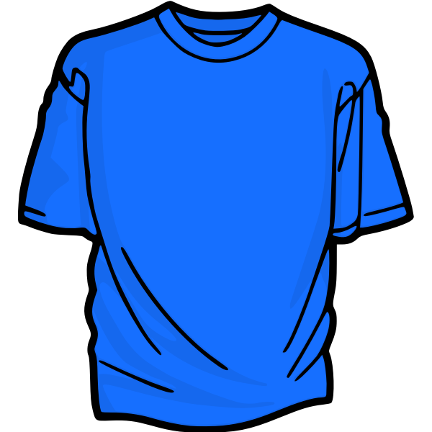
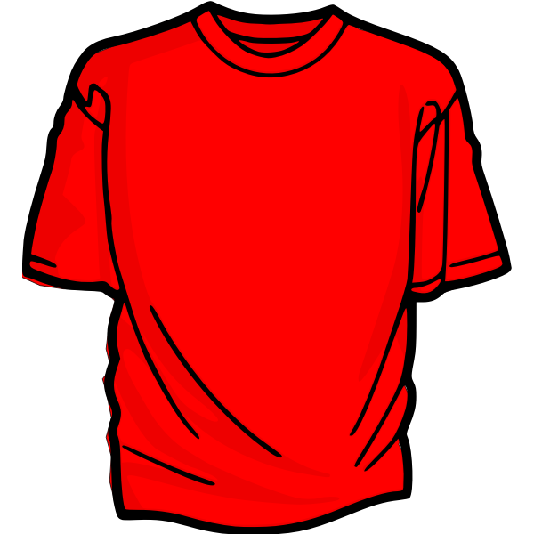
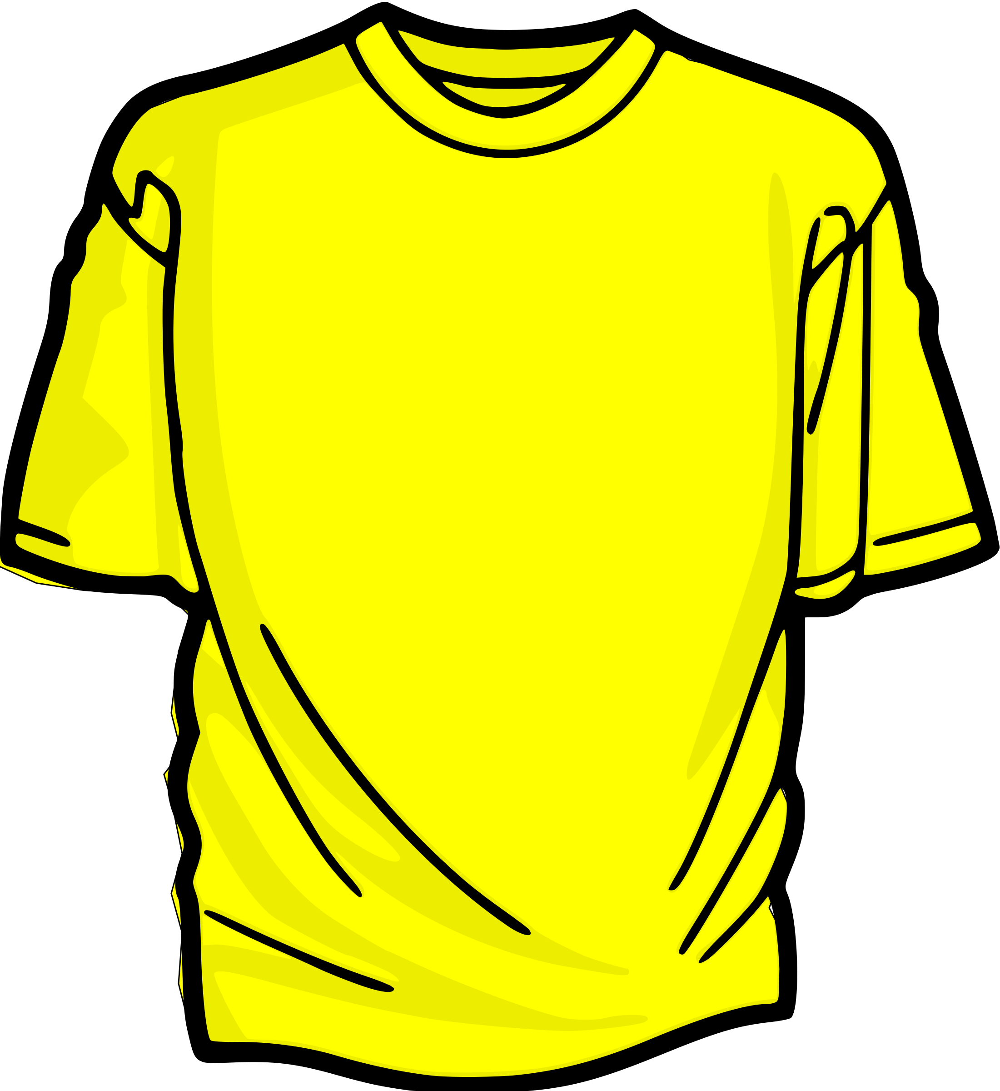
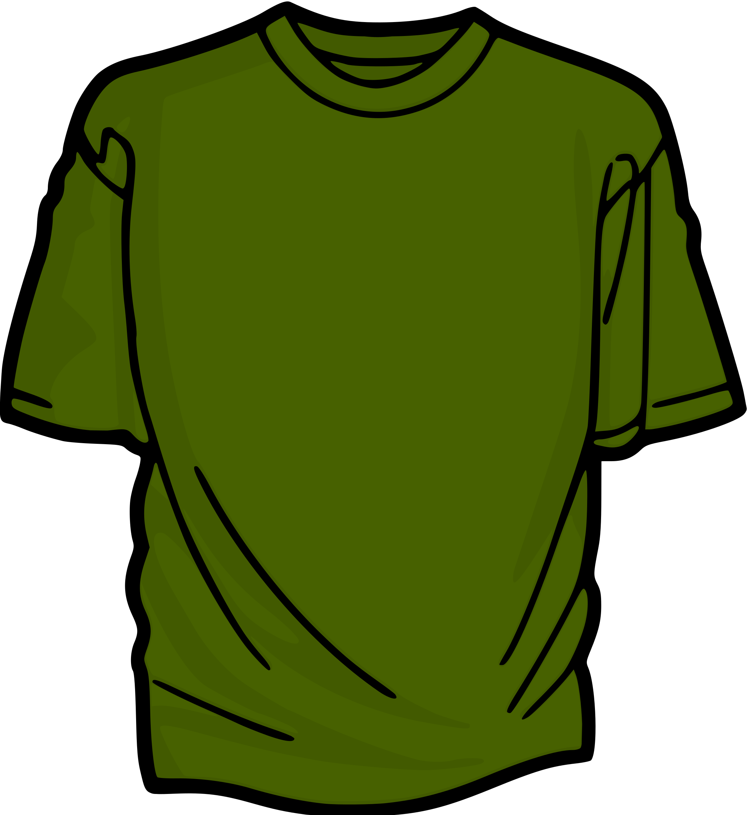
Stack implementation using Arrays
Blue Shirt | Red Shirt | Yellow Shirt | Green Shirt
0 | 1 | 2 | 3 (TOP)
Green Shirt
Yellow Shirt
Red Shirt
Blue Shirt
Push Sequence:
Push (Blue Shirt)
Push (Red Shirt)
Push (Yellow Shirt)
Push (Green Shirt)
Notes:
Have you asked yourself the question, why do people organize?
Lets go to the psychology of organizing
This predictability applies within the context of our homes, manifesting through the concept of organization

Slide 12
Push operation
0 | 1 | 2 | 3
Blue Shirt
Red Shirt
Yellow Shirt
Green Shirt
(TOP)
Push Sequence:
Green Shirt
Stack.push(“Blue Shirt”)
Yellow Shirt
Stack.push(“Red Shirt”)
Stack.push(“Yellow Shirt”)
Red Shirt
Stack.push(“Green Shirt”)
Blue Shirt
Notes:
Have you asked yourself the question, why do people organize?
Lets go to the psychology of organizing
This predictability applies within the context of our homes, manifesting through the concept of organization

Slide 13
Pop operation
0 | 1 | 2 | 3
Blue Shirt
Red Shirt
Yellow Shirt
Green Shirt
Pop Sequence:
Green Shirt
Stack.pop()
Yellow Shirt
Stack.pop()
Stack.pop()
Red Shirt
Stack.pop()
Blue Shirt
Notes:
Have you asked yourself the question, why do people organize?
Lets go to the psychology of organizing
This predictability applies within the context of our homes, manifesting through the concept of organization

Slide 14
Stack Implementation using Linked Lists
Green Shirt
Yellow Shirt
Red Shirt
Blue Shirt
Top (Head)
Green Shirt
Yellow Shirt
Red Shirt
Blue Shirt
Push Sequence:
Stack.push(“Blue Shirt”)
Stack.push(“Red Shirt”)
Stack.push(“Yellow Shirt”)
Stack.push(“Green Shirt”)
Notes:
Have you asked yourself the question, why do people organize?
Lets go to the psychology of organizing
This predictability applies within the context of our homes, manifesting through the concept of organization

Slide 15
Push operation
Green Shirt
Yellow Shirt
Red Shirt
Blue Shirt
Head (Top)
Push Sequence:
Green Shirt
Stack.push(“Blue Shirt”)
Yellow Shirt
Stack.push(“Red Shirt”)
Stack.push(“Yellow Shirt”)
Red Shirt
Stack.push(“Green Shirt”)
Blue Shirt
Notes:
Have you asked yourself the question, why do people organize?
Lets go to the psychology of organizing
This predictability applies within the context of our homes, manifesting through the concept of organization

Slide 16
Pop operation
Green Shirt
Yellow Shirt
Red Shirt
Blue Shirt
Pop Sequence:
Green Shirt
Stack.pop()
Yellow Shirt
Stack.pop()
Stack.pop()
Red Shirt
Stack.pop()
Blue Shirt
Notes:
Have you asked yourself the question, why do people organize?
Lets go to the psychology of organizing
This predictability applies within the context of our homes, manifesting through the concept of organization

Slide 17
Framework Implementation
The Java Collection framework provides a Stack class that models and implements a Stack data Structure.
The Stack Class is included in the Java.util Package
This framework provides a ready-made architecture to implement different classes including stacks
Notes:
Have you asked yourself the question, why do people organize?
Lets go to the psychology of organizing
This predictability applies within the context of our homes, manifesting through the concept of organization

